Slide 1

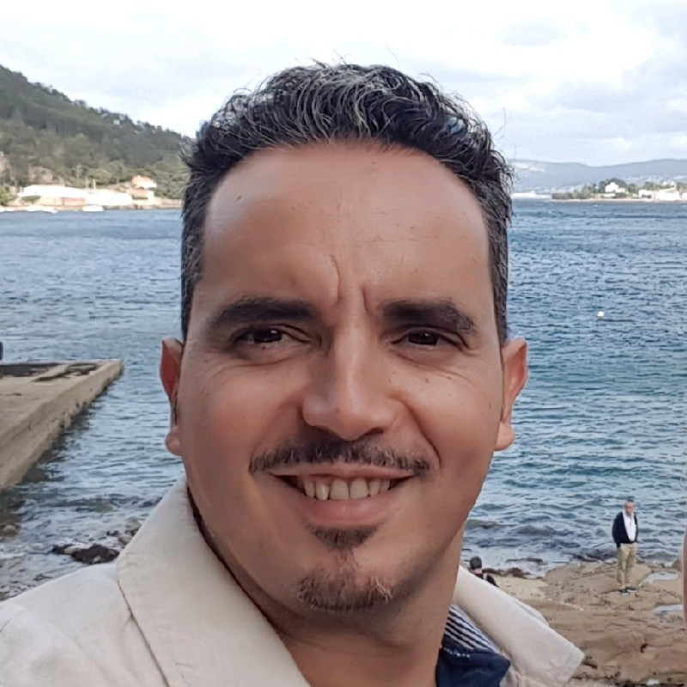

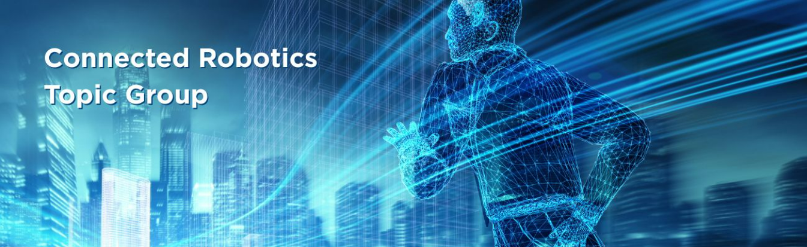
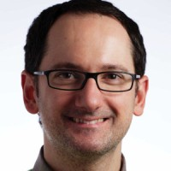

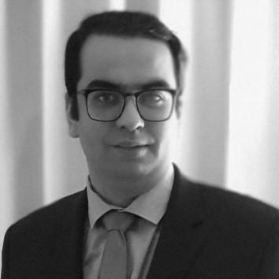

euRobotics Connected Robotics Topic Group launch webinar: Vision and Activities
Thursday 16th October 16:00-17:30 CEST
euRobotics MSTEAM link
Agenda
Welcome and opening (5 min) - euRobotics office
Three presentations (20 min each) – TG coordinators
Activity plan & discussions (15 min) – TG coordinators
Any other business (5 min)
Prof Alberto Jardón Huete
Prof Stefano Ghidoni
Advanced Comm. & Sensing
Collaborative Use Case Development
AI-Native Solutions
Cyber-Physical Systems
Digital Twins & Real-Time Monitoring
Fleet Robotics Comm
Dr Syed Ali Raza Zaidi
Notes:
Share with Ali-no response

